Slide 1
Blood donation
Navin Bhattarai
Bibek Chaudhary
Subash Adhikari
Samir Maharjan
Sumit Bajrachrya

Slide 2
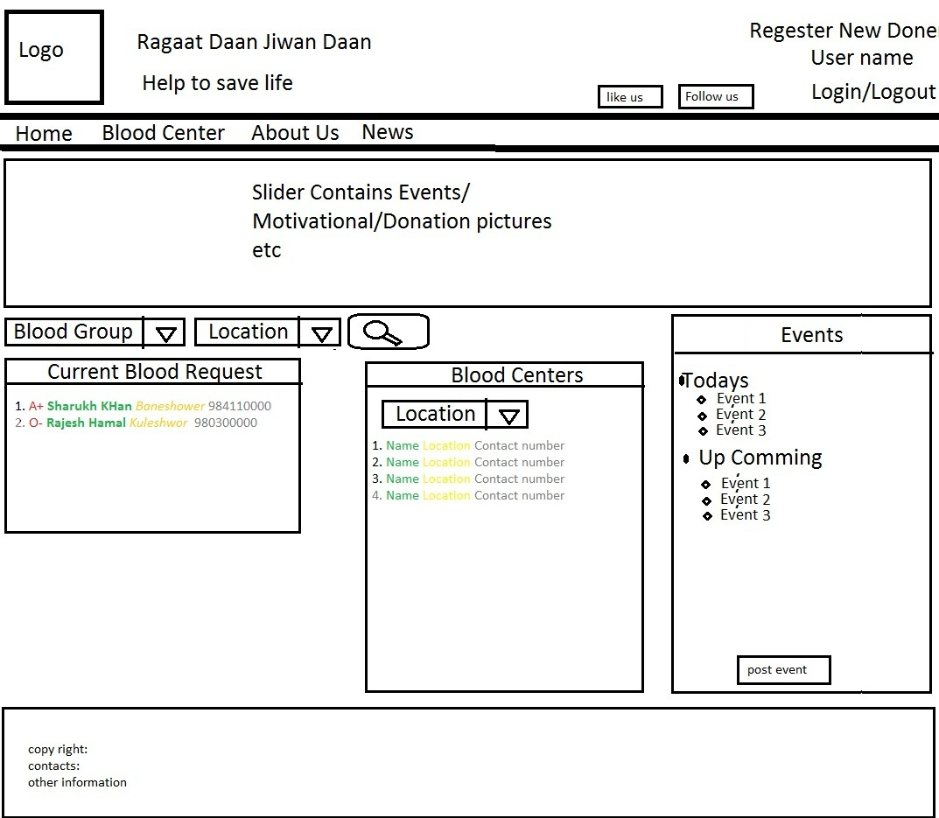
Home page

Slide 3
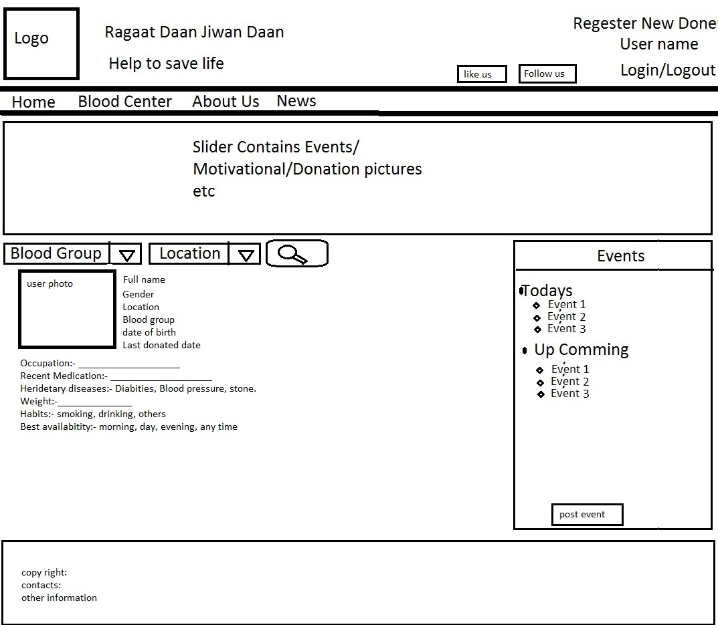
Donor's Profile

